Slide 1
Persistent Array
Kanko Ghosh
B-CSE II

Slide 2
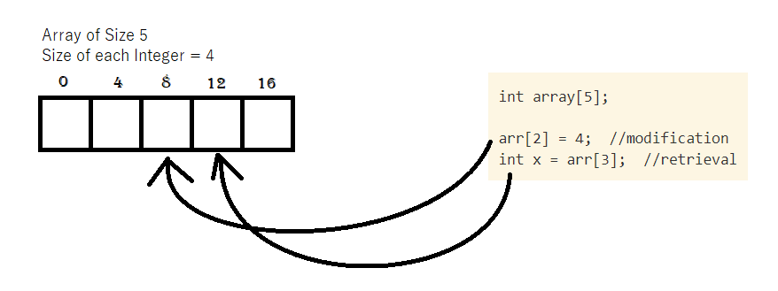
Ephimeral Array
Collection of items of same type stored in contiguous memory location
An element from a particular position can be retrieved or modified directly by calculating address of a location
Eg.
Required address of a position in an array = starting address+ (required index * size of data type)

Slide 3
Operations on array
storeArray(a, i, e): store the value present in e, in the i-th element of array a
retrieveArray(a, i) : return the value of the i-th element of array a

Slide 4
Persistent Data Structure
Persistency can be achieved in a data structure, when we can preserve the previous version of itself even after modifying the data structure
Persistency can be partial: older versions can be retrieved but cannot be modified; and fully persistent: older versions can be modified as well as read by the user
Array can also be made persistent by few techniques

Slide 5
Copy on write method
Method 1

Slide 6
Copy on Write method
On updating an array, a new array is created (allocating memory followed by copying the data) and the corresponding update is made in the new array
Operations:
storeArray(a, v, i, e): store the value present in e, in the i-th element of array a of version v
retrieveArray(a, v, i) : return the value of the i-th element of array a of version v

Slide 7
Copy on Write method
Fully Persistent and easy to implement
Worst case time complexity:
Storing: O(n), n is number of elements in array.
Retrieval: O(1), when the different array versions are stored in an array (using array of pointers)
Space Requirement: O(n*v), n is number of elements in array, v is number of versions (LIMITATION!!)

Slide 8
Limitation and Solution
Limitation: Same elements stored multiple times
Solution: only the element which is changed, is stored in the array

Slide 9
Fat Node Method
Method 1

Slide 11
Fat Node Method
Target: Only the particular value of an element in an array is stored in the array, when it is changed.
Approach: Each element in the persistent array will point to a linked list, which is storing the modified values at a particular position of an array, along with the versions in linear fashion
Retrieval: on requesting the value of a particular version at a particular position, the linked list pointed to by the element of the array is traversed.

Slide 12
Comparison in Fat Node Method
Partial Persistent
Fully Persistent
Since the older versions cant be modified, no version history is required
On requesting a version, a value is chosen whose version is just less than or equal to the requested version
Version history (stored in tree/trie/array) is required to check the ancestor of a requested version
On requesting a version, the version just less than the requested version, may not be the ancestor of requested version, so the version history must be checked.

Slide 14
Fully persistent array
Implementation

Slide 15
Simulation
Query: Init(version = 0, arr{1,2,3,4}, size = 4}
Version Track
(for simulation purpose)
Val = 1, Ver = 1
Val = 2, Ver = 1
Val = 3, Ver = 1
Val = 4, Ver = 1
1 2 3 4
0 1 2 3 4 5 6 7 8 9 10
Version History
0

Slide 16
Simulation
Query: StoreArray(version = 1, position = 1, value = 10)
Version Track
(for simulation purpose)
Val = 1, Ver = 1
Val =10, Ver =2
Val = 3, Ver = 1
Val = 4, Ver = 1
1 2 3 4
1 10 3 4
Val = 2, Ver = 1
Version 2 created,
from version 1
0 1 2 3 4 5 6 7 8 9 10
Version History
0
1

Slide 17
Simulation
Query: StoreArray(version = 1, position = 2, value = 10)
Version Track
(for simulation purpose)
Val = 1, Ver = 1
Val =10, Ver =2
Val =10, Ver =3
Val = 4, Ver = 1
1 2 3 4
1 10 3 4
1 2 10 4
Val = 2, Ver = 1
Val = 3, Ver = 1
Version 3 created,
from version 1
0 1 2 3 4 5 6 7 8 9 10
Version History
0
1
1

Slide 18
Simulation
Query: StoreArray(version = 2, position = 0, value = 5)
Version Track
(for simulation purpose)
Val = 5, Ver = 4
Val =10, Ver =2
Val =10, Ver =3
Val = 4, Ver = 1
1 2 3 4
1 10 3 4
1 2 10 4
Val = 1, Ver = 1
Val = 2, Ver = 1
Val = 3, Ver = 1
5 10 3 4
Version 4 created,
from version 2
0 1 2 3 4 5 6 7 8 9 10
Version History
0
1
1
2

Slide 19
Simulation
Query: StoreArray(version = 3, position = 1, value = 10)
Version Track
(for simulation purpose)
Val = 5, Ver = 4
Val =10, Ver =5
Val =10, Ver =3
Val = 4, Ver = 1
1 2 3 4
1 10 3 4
1 2 10 4
Val = 1, Ver = 1
Val =10, Ver =2
Val = 3, Ver = 1
5 10 3 4
1 10 10 4
Val = 2, Ver = 1
Version 5 created,
from version 3
0 1 2 3 4 5 6 7 8 9 10
Version History
0
1
1
2
3

Slide 20
Simulation
Query: StoreArray(version = 4, position = 1, value = 11)
Version Track
(for simulation purpose)
Val = 5, Ver = 4
Val =11, Ver =6
Val =10, Ver =3
Val = 4, Ver = 1
1 2 3 4
1 10 3 4
1 2 10 4
Val = 1, Ver = 1
Val =10, Ver =5
Val = 3, Ver = 1
5 10 3 4
1 10 10 4
Val =10, Ver =2
5 11 3 4
Version 6 created,
from version 4
Val = 2, Ver = 1
Version History
0 1 2 3 4 5 6 7 8 9 10
0
1
1
2
3
4

Slide 21
Simulation
Query: StoreArray(version = 3, position = 3, value = 8)
Version Track
(for simulation purpose)
Val = 5, Ver = 4
Val =11, Ver =6
Val =10, Ver =3
Val = 8, Ver = 7
1 2 3 4
1 10 3 4
1 2 10 4
Val = 1, Ver = 1
Val =10, Ver =5
Val = 3, Ver = 1
Val = 4, Ver = 1
5 10 3 4
1 10 10 4
Val =10, Ver =2
5 11 3 4
Version 7 created,
from version 3
1 2 10 8
Val = 2, Ver = 1
Version History
0 1 2 3 4 5 6 7 8 9 10
0
1
1
2
3
4
3

Slide 22
Retrieval algorithm
Start at the node pointed to by pointer at required position
WHILE (required version ≠ node version)
IF (req version < node version) traverse to the next node
ELSEIF (required version > node version) look into the version history to find the immediate ancestor
ELSE return value at the node
ENDIF
ENDWHILE

Slide 23
Simulation
Query: Retrieve(version = 7, position = 1)
Start at Node from Position 2
Node Version ≠ required version
Node Version < required version,
so, immediate ancestor, 3
is required version now
Val = 5, Ver = 4
Val =11, Ver =6
Val =11, Ver =6
Val =10, Ver =3
Val = 8, Ver = 7
Node Version > required version,
so, go to next node
Val = 1, Ver = 1
Val =10, Ver =5
Val = 3, Ver = 1
Val = 4, Ver = 1
Val =10, Ver =5
Node Version > required version,
so, go to next node
Val =10, Ver =2
Node Version < required version,
so, immediate ancestor, 1
is required version now
Val =10, Ver =2
Version 6 created,
from version 4
Node Version > required version,
so, go to next node
Val = 2, Ver = 1
Val = 2, Ver = 1
Version History
Node Version = Required version, SO Val = 2 returned
0 1 2 3 4 5 6 7 8 9 10
1
1
2
3
4
3
0
1
3

Slide 24
Analysis
Time Complexity:
Update: O(1)
Retrieve: O(n+h), h = height of the version tree and n = number of modifications at a particular node.
Space Complexity: O(n+2m), where n = length of array, m = number of modifications (2 m because, of version history and pointer memory overhead.

